Slide 1



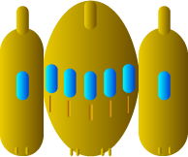
Spaceship correct positioning
0
Y
Y
X
X

Slide 2

Correct positioning of the bullet
0
Bullet starting position
Y
X

